Slide 1
Introduction to Data Analysis in R - Day 1
Randi L. Garcia
DATIC Introduction to R Workshop
Session 1: June 7th and 8th
Session 2: June 21st and 22nd

Slide 2
Introductions
Me
Randi L. Garcia, Assistant Professor in Psychology and Statistical & Data Sciences at Smith College
Research interests
Data analysis software experiences
You…
Who are you, where are you coming from?
What brings you here? What do you hope to get out of this workshop?

Slide 3
Day 1
RStudio environment, packages, and R Markdown
Making figures
Data cleaning
Descriptive stats, correlations, reliability, creating scale scores

Slide 4
Day 2
T-test, ANOVA, and regression
Preparing APA style manuscripts
Exploratory Factor Analysis (EFA) and Confirmatory Factor Analysis (CFA)
Path Analysis and Structural Equation Modeling (SEM)

Slide 5
Why Learn to use R?
Many of the reasons you already gave…
High cost of SPSS, especially for students
Reproducibility
My personal reasons:
It can do all the usual analyses, MLM, and SEM
The R programming language versus SPSS syntax
Ability to create fully reproducible results, including automating manuscript updating after data changes
Many teaching reasons
Let’s discuss more during breaks…

Slide 6
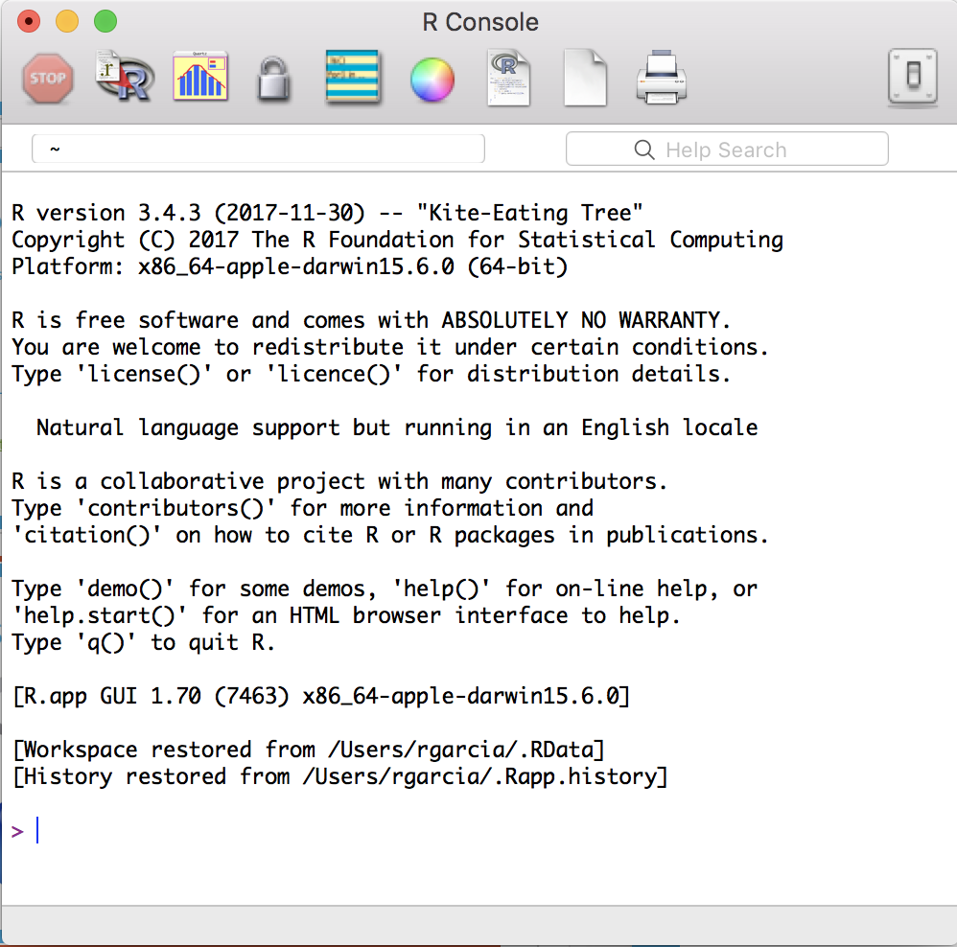


R and RStudio

Slide 7
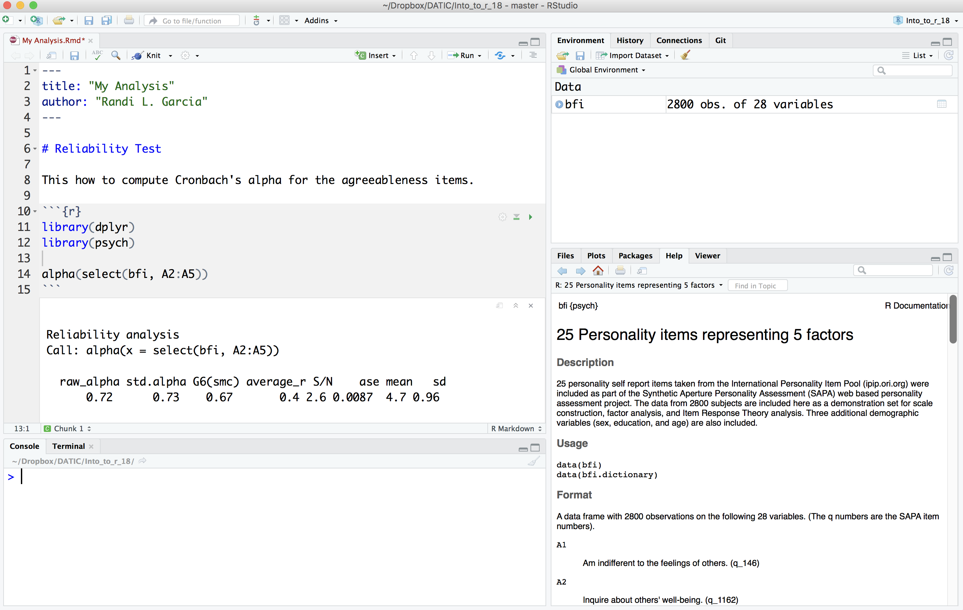
R and RStudio

Slide 8
Let’s Use R Studio!
Bookmark this website:
bit.ly/intro-r-website
Download ALL materials, including R-code, here:
bit.ly/intro-r-materials

Slide 9
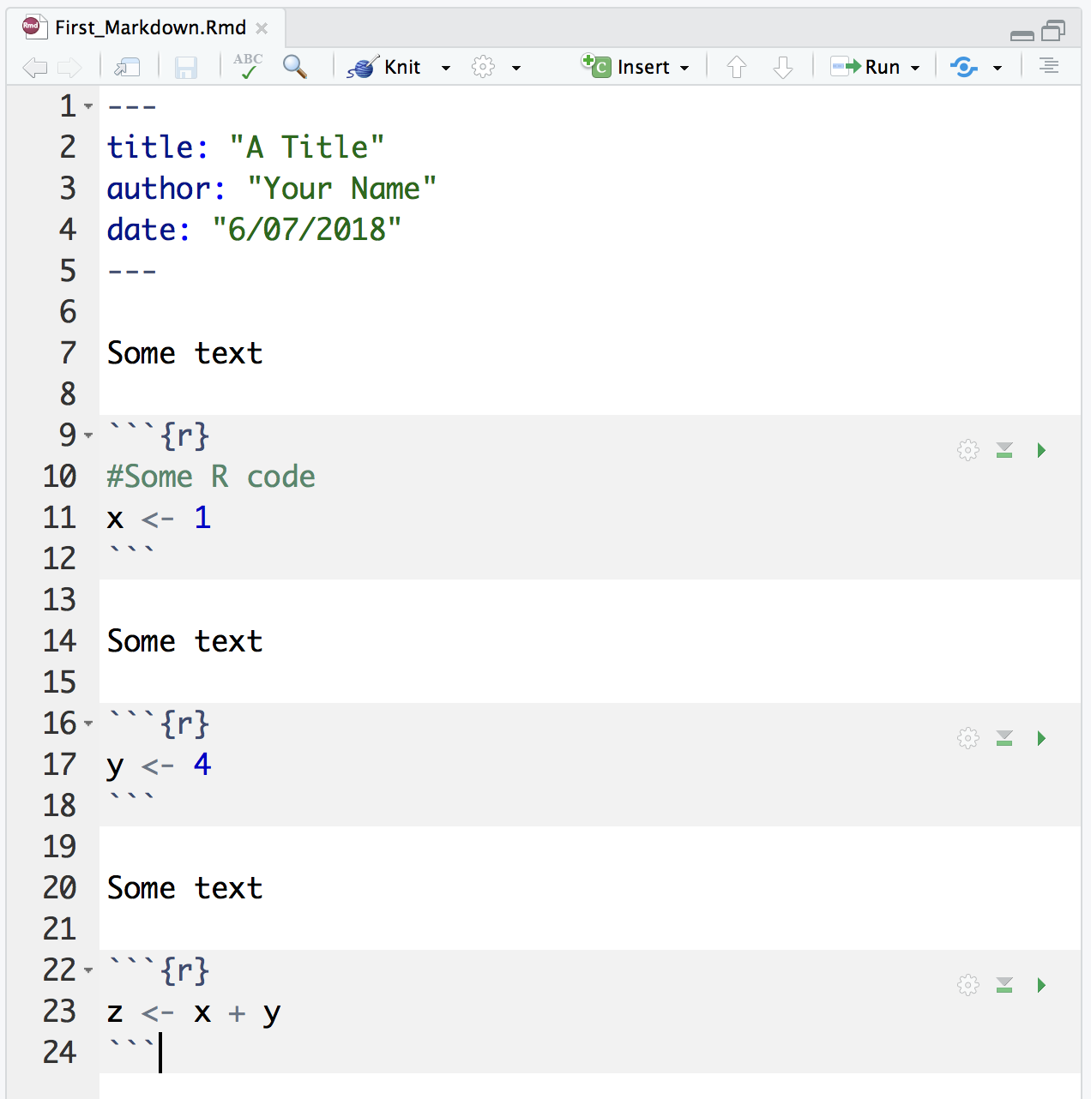
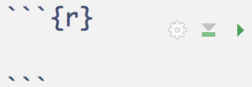
R Markdown is where your analyses live!
A file of type “.Rmd”
Starts with some basic information in the “YAML header”
A series of text and “code chunks”:
We will need to install some stuff…

Slide 10
R Markdown is where your analyses live!
A file of type “.Rmd”
Starts with some basic information in the “YAML header”
A series of text and “code chunks”:
We will need to install some stuff…

Slide 11
R Markdown is where your analyses live!
A file of type “.Rmd”
Starts with some basic information in the “YAML header”
A series of text and “code chunks”:
We will need to install some stuff…

Slide 12
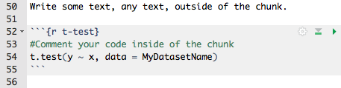
Anatomy of a Code Chunk
Run all of the code in this chunk
Giving your chunk a name helps find it later
”Bookends” to signify code is starting and ending
Chunk options (more on that later)
Run all of code in the chunks above
The R code goes between the bookends

Slide 13
R Studio
Intro_to_R.Rmd
packages_descriptive_stats.Rmd

Slide 14
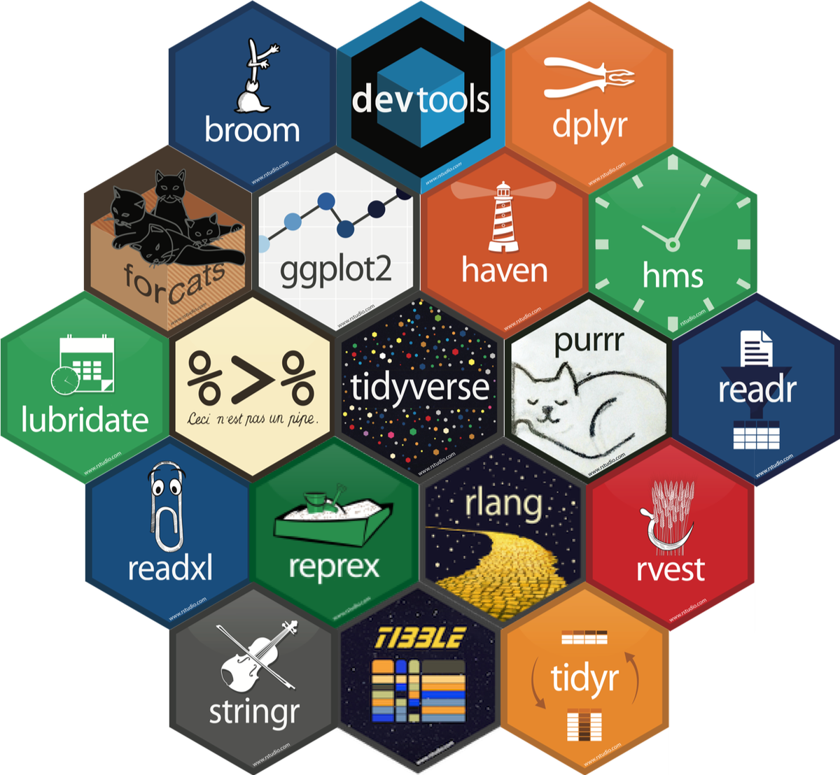
Which R?
There are >10,000 packages in R
This can feel overwhelming for new users
To make matters worse, “R people” are opinionated about which packages are “best”
There is NO consensus! Eventually you’ll be able to decide for yourself, for now, I’ll decide for you…
We are going to learn some of the tidyverse packages in this workshop
Hadley Wickham

Slide 15
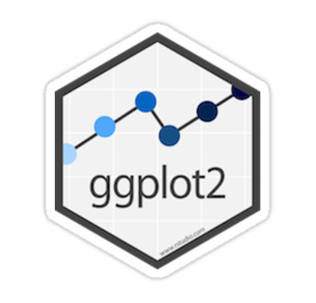
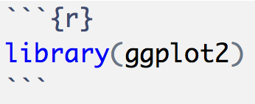
Making Figures with ggplot2
As with everything else, there are lots of ways to make figures in R
Base R
Lattice graphics
The ggplot2 package
We’ll be learning the ggplot2 package.
It makes beautiful visualizations
It’s popular so there is a lot of help on the internet and companion code
It works well with all of the tidyverse packages

Slide 16
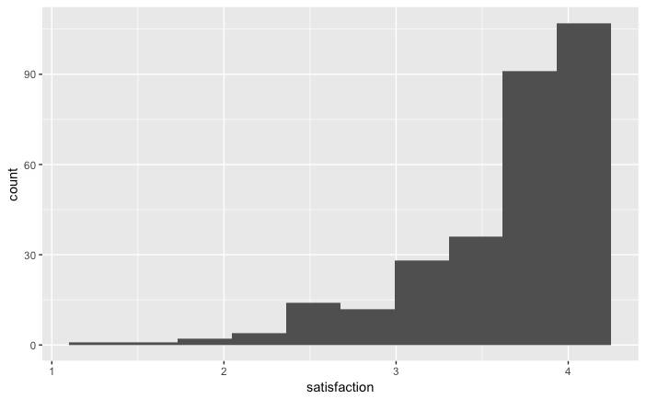
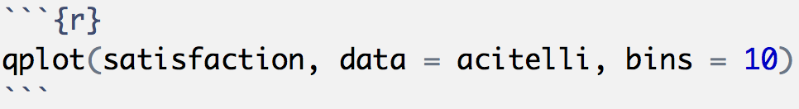
Making Figures with ggplot2
The easiest figures are made with the qplot() function
The q stands for quick!
Guesses which kind of figure out want
Customize
It needs to know the data, but no dollar signs!

Slide 17
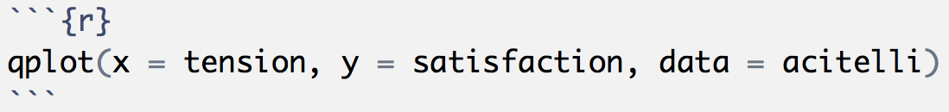
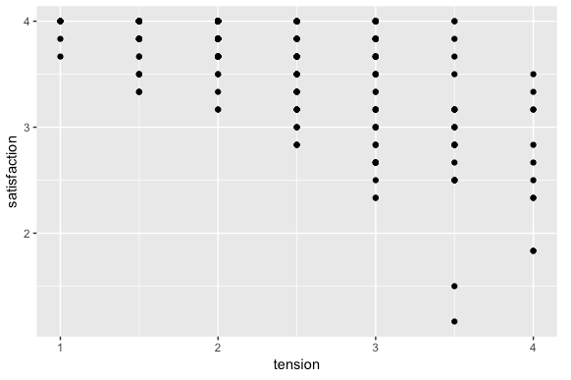
Making Figures with ggplot2
“Two numerical variables? Oh, you probably want a scatterplot…”

Slide 18
Making Figures with ggplot2
The qplot() function is good for quick visualizations
Good for probably 80% of what you’d want to do while analyzing data
But, you’ll use the ggplot() function for anything more involved, like for making figures for publication
The ggplot2 packages uses the “grammar of graphics"

Slide 19
Making Figures with ggplot2
We independently specify pieces of the graph using the “grammar of graphics”
Building blocks:
Data
Geometric objects (the actual things we’ll draw: points, lines, boxplot, histograms, etc.)
Aesthetic mappings (what and where we’ll draw: x-axis, y-axis, color, fill, shape, size, linetype, etc.)
Statistics (implied or specified computing to be done)
Scales (range of values, colors, or shapes)
Facets (the panes—there can be more than 1, layers in SPSS)
Guides (legends—what the humans see)

Slide 20
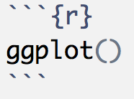


Slide 21
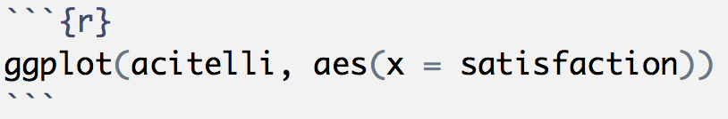
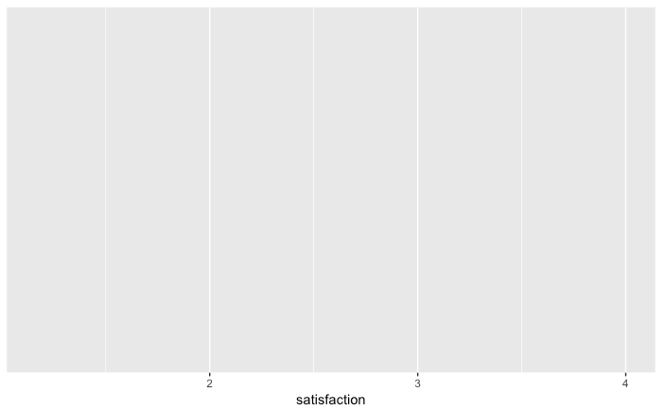
The data comes first
Where’s the stuff??
Specify “aesthetic mappings” with the aes() function

Slide 22
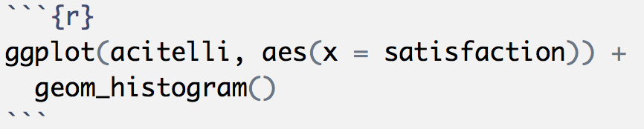
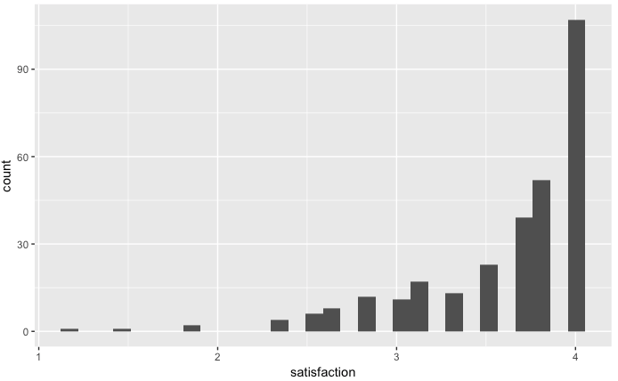
Gotta add some geom’s
Statistic
Geometric object

Slide 23
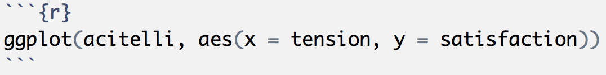
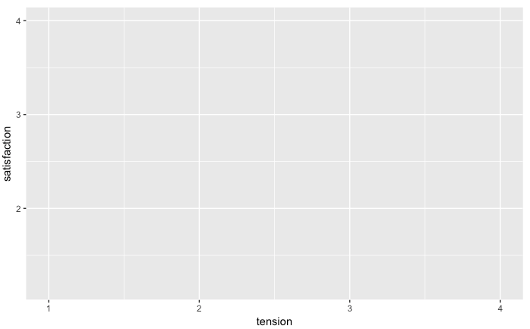

Slide 24
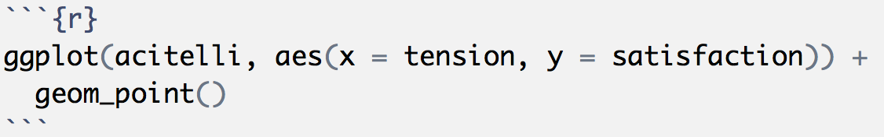
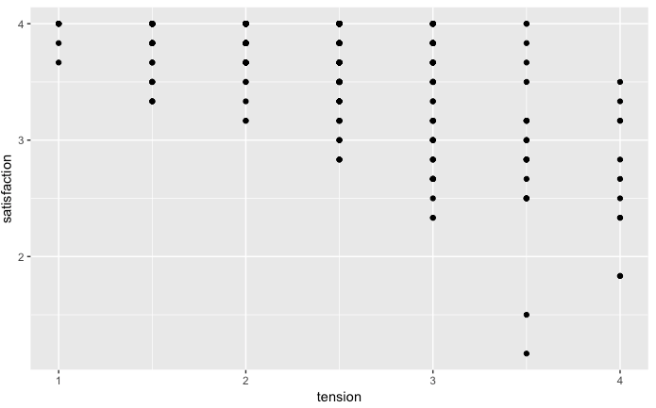

Slide 25
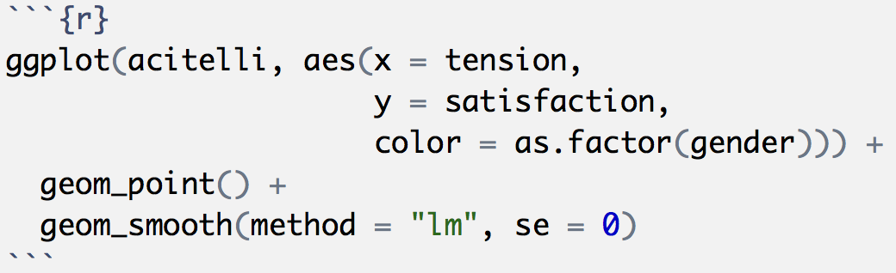
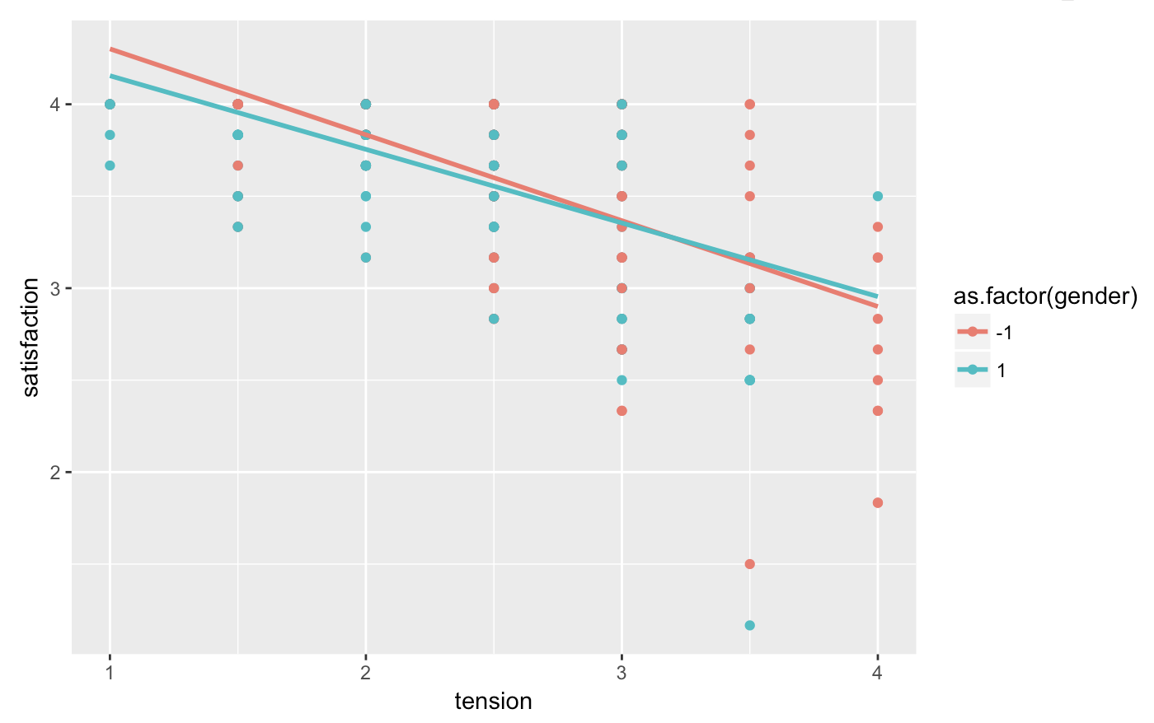
Map to color!
Layer on those geoms!
What do you think would happen if we mapped color to self_pos, a numerical variable?

Slide 26


R Markdown File
Intro_to_ggplot2.Rmd

Slide 27

Data Cleaning
The package we’ll use for data cleaning is called dplyr.
The Verbs
filter()
mutate()
rename()
arrange()
select()
summarize()
group_by()

Slide 28
Data Cleaning
Each verb performs familiar operations of a dataset
Verb | What is does | …in SPSS
mutate() | Creates new variables | COMPUTE (or transform in menu)
filter() | Filters for specific cases | FILTER (or select data in menu)
arrange() | Sorts using some logic | SORT
select() | Subsets for only certain variables | DROP
group_by() | Groups dataset by a categorical variable | Like split file in menu
summarize() | Create a summary table | Descriptive statistics

Slide 29
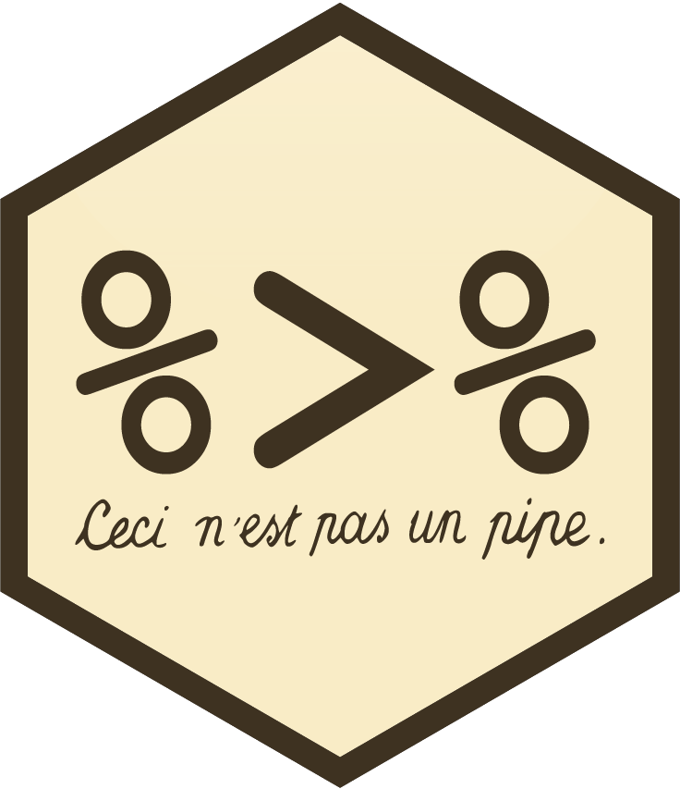
Data Cleaning
We will use the pipe operator to combine verbs!
The pipe:
%>%
filter(dataset, age >= 18)
…is the same as:
dataset %>% filter(age >= 18)

Slide 30
Data Cleaning
Why the pipe!?!?
Instead of reading/writing:
select(filter(mutate(dataset, bdi = bdi1 + bdi2 + bdi3), age >= 18) bdi, soc_sprt)
We can write:
dataset %>%
mutate(bdi = bdi1 + bdi2 + bdi3) %>%
filter(age >= 18) %>%
select(bdi, soc_sprt)

Slide 31
Data Cleaning
If you wanted to save this two-variable dataset:
dataset_small <- dataset %>%
mutate(bdi = bdi1 + bdi2 + bdi3) %>%
filter(age >= 18) %>%
select(bdi, soc_sprt)

Slide 32
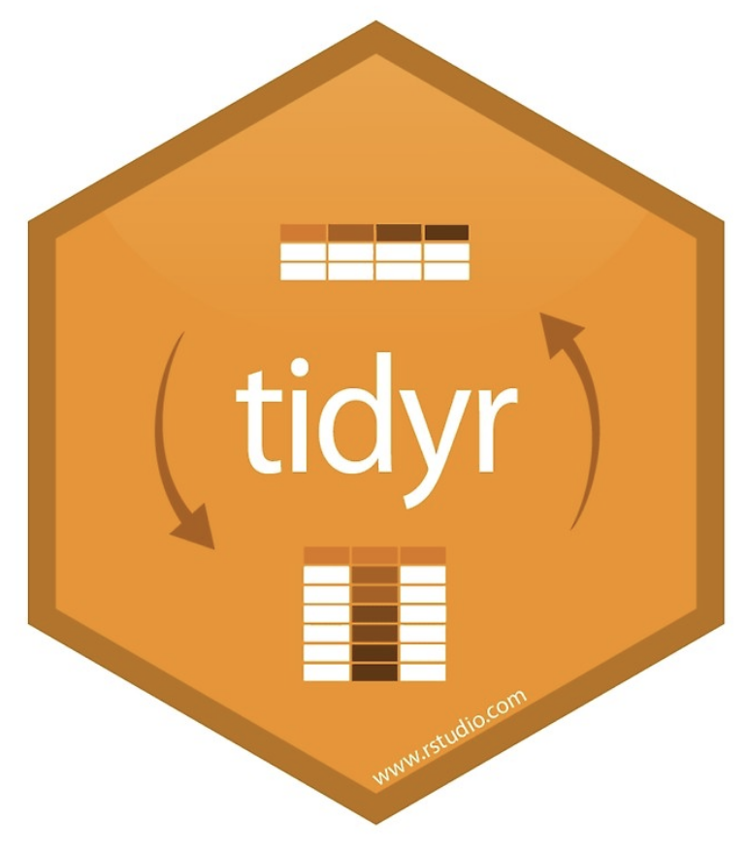
Data Cleaning
There are also verbs for joining two tables
Adding cases from another dataset that has the same variables
And also when they do not have exactly the same variables
Adding variables from another dataset
These variables can be measured at the same level or at a higher level, as long as there are index variables.
And verbs for transforming data from
Wide-to-long
Long-to-wide
We can learn these on Day 3 if you want…?

Slide 33
R Markdown File

Slide 34
Correlation Matrices, Reliability, and t-Tests
For correlation matrices and Cronbach’s alpha we’ll use the package called psych
For t-Tests I recommend you use mosaic because it has that (now familiar) formula, then data, syntax

Slide 35
Correlation Matrices, Reliability, and t-Tests
Correlation Matrix
corr.test()
I like to use this with select():
corr.test(select(acitelli, tension, self_pos, other_pos, satisfaction))
Reliability
alpha()
Also handy with select:
alpha(select(acitelli, sat1, sat2, sat3, sat4, sat5, sat6))
vars for matrix
items for alpha

Slide 36
Correlation Matrices, Reliability, and t-Tests
Independent samples and paired samples t-tests
t.test(satisfaction ~ Gender, data = acitelli)
t.test(self_pos, other_pos, data = acitelli, paired = TRUE)

